Slide 1
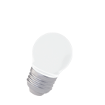
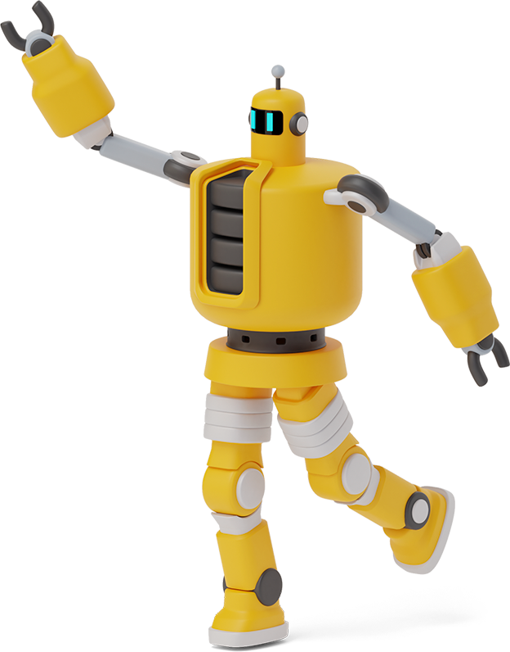
Python Playground

Slide 2
Roadmap
Homework Takeup
Functions continued
For Loops
1
3
5
2
4
6
Review of Past Class
Class Activity x 2
Lists

Slide 3
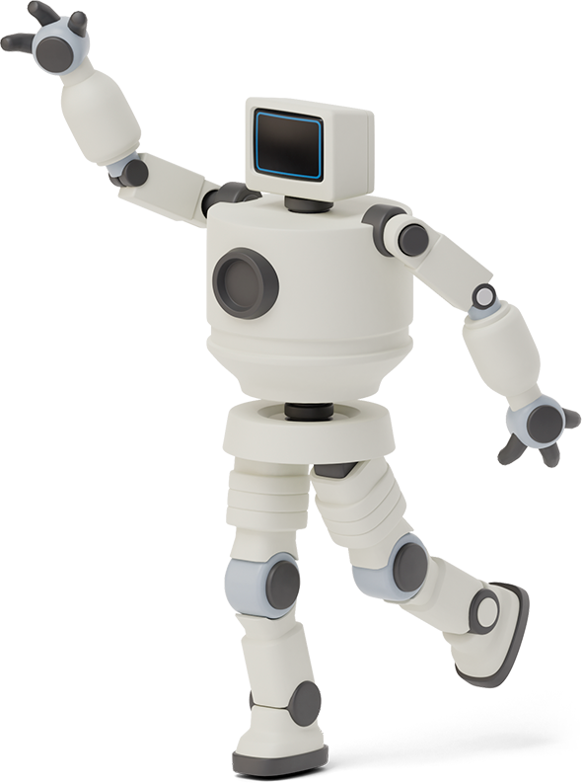

Homework Link
https://github.com/Asfandyar-Khan/PythonPlayground/blob/main/index.md
Contains all lectures and Google Colab notebooks
Contains homework which will be a word document
Does anyone have any homework questions?

Slide 4
Review of Last Week
Input function examples
What is a function?
What is the syntax?
How do we call functions?
Functions examples

Slide 5
Let’s Review Functions!

Slide 6
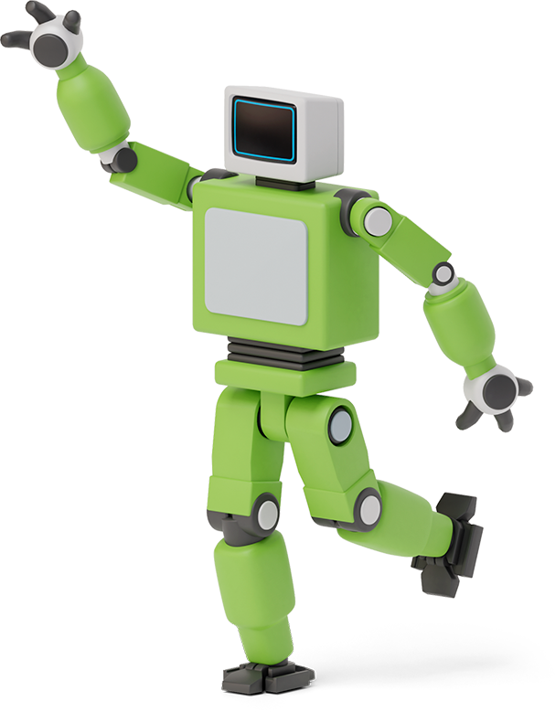


What is a Function?
A function is a set of statements that run when the function is called
Python has many built in functions!
print(), type(), int(), float(), str(), round()
What if we want to build our own functions?

Slide 7
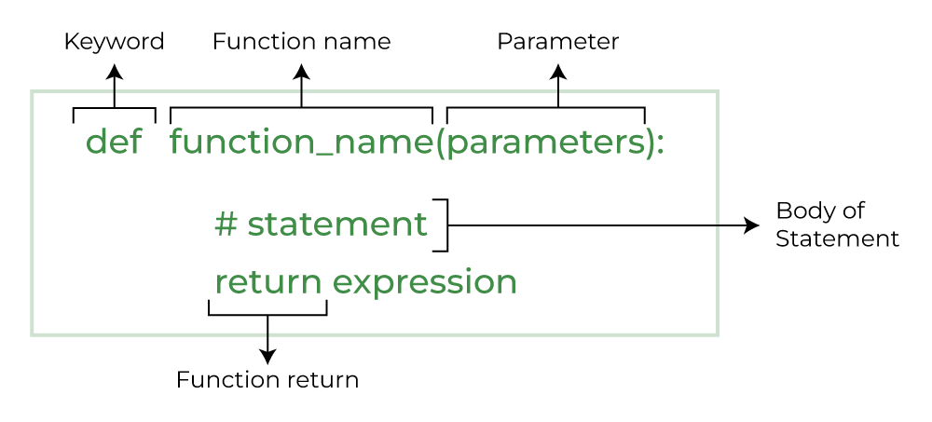
What is a Function?

Slide 8
Function Example
Write a function that outputs a few of the
introductory sentences we covered in
past classes
def favourite_sentences():
print(“My name is Bob”)
print(“My age is 10”)
Does anyone want to guess what this function will do?

Slide 9
Function Example 2
def print_twice(string):
print(string)
print(string)
Notice how string is now added as a parameter
How does this function work?
What will happen if you call this function?
Can this function be called without any input?

Slide 10

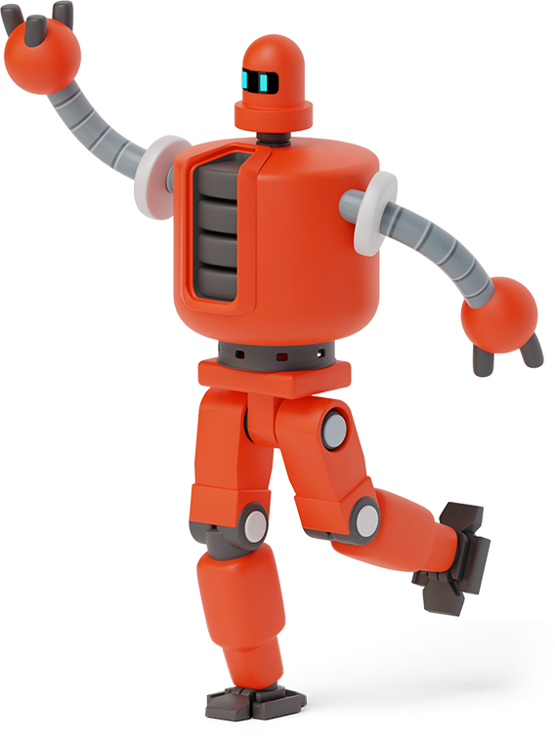
Class Activity
Create a function that prints out your favourite food!
Everytime this function is called, your favourite food is going to be printed as text in the Python editor

Slide 11

Class Activity
Create a function called greet(name) that takes one argument (name) and prints:
Hi, [name]! Nice to meet you.
Call the function with your own name.
Example output:
Hi, Sarah! Nice to meet you.

Slide 12

For Loops
A for loop iterates over a sequence – such as a string, list, or tuple
Allows you to run a block of code repeatedly
This occurs once for each item in the sequence
Syntax:
for item in iterable:
# Code to be executed for each item

Slide 13
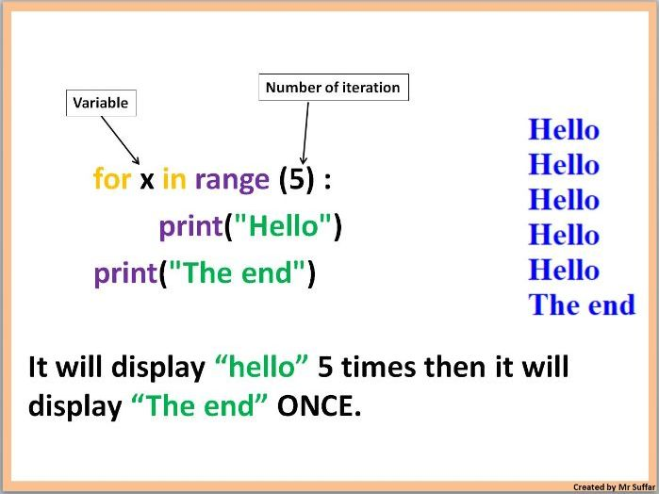
For Loops

Slide 14
For Loops – range() function
range() function
range(start,stop,step): 3 parameters
range(start): initiate the sequence of numbers with the start number
range(stop): will generate a sequence of numbers from 0 up to, but not including, stop
range(step): will jump between start and stop numbers by increment of step

Slide 15
Lists – Data Structure
Lists
Lists are a data structure that is used to collect data items
They are mutable (changeable)
Lists maintain a defined order
The first item is given priority
Then the second item, and so on...

Slide 16
Thanks!
Any questions?

